Slide 1
Informatica Training
Presenter – Priyanka Jyoti

Slide 2
Topics
ETL Basics
ETL Overview
Data Migration Methodology
Data Warehousing Architecture
Data Warehouse Definition
Different ETL Tools in the Market
Informatica PowerCenter
Informatica PowerCenter Architecture
Informatica PowerCenter Client Tools
Designer
Designer Overview
Transformations Overview
Basic Transformations used in Designer
Source Qualifier
Filter Transformation
Router Transformation
Expression Transformation
Aggregator Transformation
Update Strategy Transformation
Joiner Transformation

Slide 3
Topics(Contd.)
Sorter Transformation
Sequence Generator Transformation
Normalizer Transformation
Stored Procedure Transformation
Lookup Transformation
Workflow Manager
Workflow Basics
Session Properties
Workflow Properties
Scheduling and Running Workflows
Workflow Monitor
Workflow Monitor Details
Repository Manager
Repository
Repository Manager Tasks
Integration Service
Repository Service
Administration Console
PMCMD

Slide 4
ETL Basics

Slide 5
ETL Overview
Extract - Transform – Load (ETL) is the foundation of a Data Integration Solution.
Data Integration (DI) solutions include – Data Migration, Real Time Data Integration, Data warehousing.

Slide 6
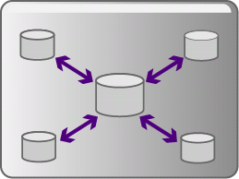


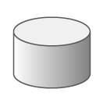

Data Migration Methodology
Source
Systems
0. Initial Data Setup
Target
1.Access
2.Discover
3.Tranform
/ Cleanse
4.Load
5.Reconcile
Increment / Iterate

Slide 7
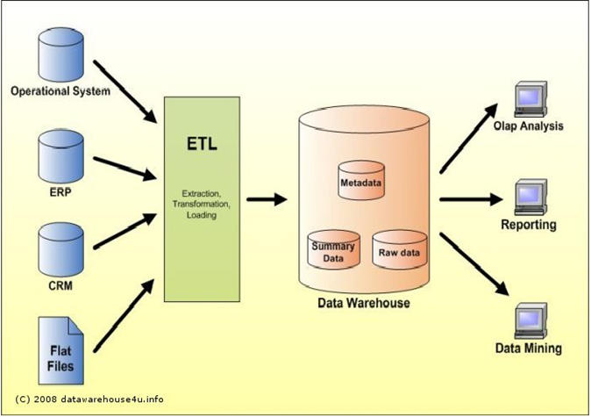
Data Warehousing Architecture

Slide 8
Data Warehouse Definition
A data warehouse is
subject-oriented,
integrated,
time-variant,
nonvolatile
collection of data in support of management’s decision making process.

Slide 9
Different ETL Tools in the Market
Informatica
Datastage
Abinitio
SSIS
SQL Server 2000 DTS
Oracle 8i Warehouse Builder

Slide 10
Informatica PowerCenter Overview

Slide 11
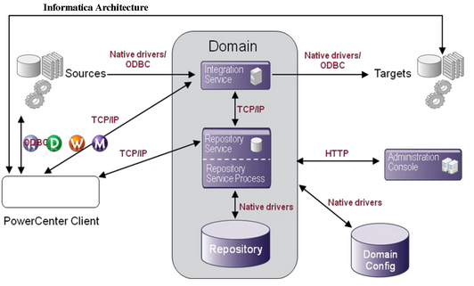
Informatica PowerCenter Architecture

Slide 12
Informatica PowerCenter Client Tools
Designer
To add source and target definitions to the repository
To create mappings that contain data transformation instructions
Workflow Manager
To create, schedule and execute sessions and workflows
Workflow Monitor
To monitor sessions and workflows for debugging.
Repository Manager
To create and administer the Metadata
To create Repository Users and Groups, assign Privileges and Permissions
Manage Folders and Locks
Administration Console
Web based application for administrative tasks like managing logs and configure nodes

Slide 13
Designer

Slide 14
Designer Overview
Informatica’s Designer is the client application used to create and manage sources, targets, and the associated mappings between them.
The Designer allows you to work with multiple tools, in multiple folders, and in multiple repositories at a time.
The client application provides five tools with which to create mappings:
Source Analyzer - To import or create source definitions for flat file, ERP, and relational sources.
Target Designer - To import or create target definitions.
Transformation Developer - To create reusable object that generates or modifies data.
Mapplet Designer - To create a reusable object that represents a set of transformations.
Mapping Designer - To create mappings.

Slide 15
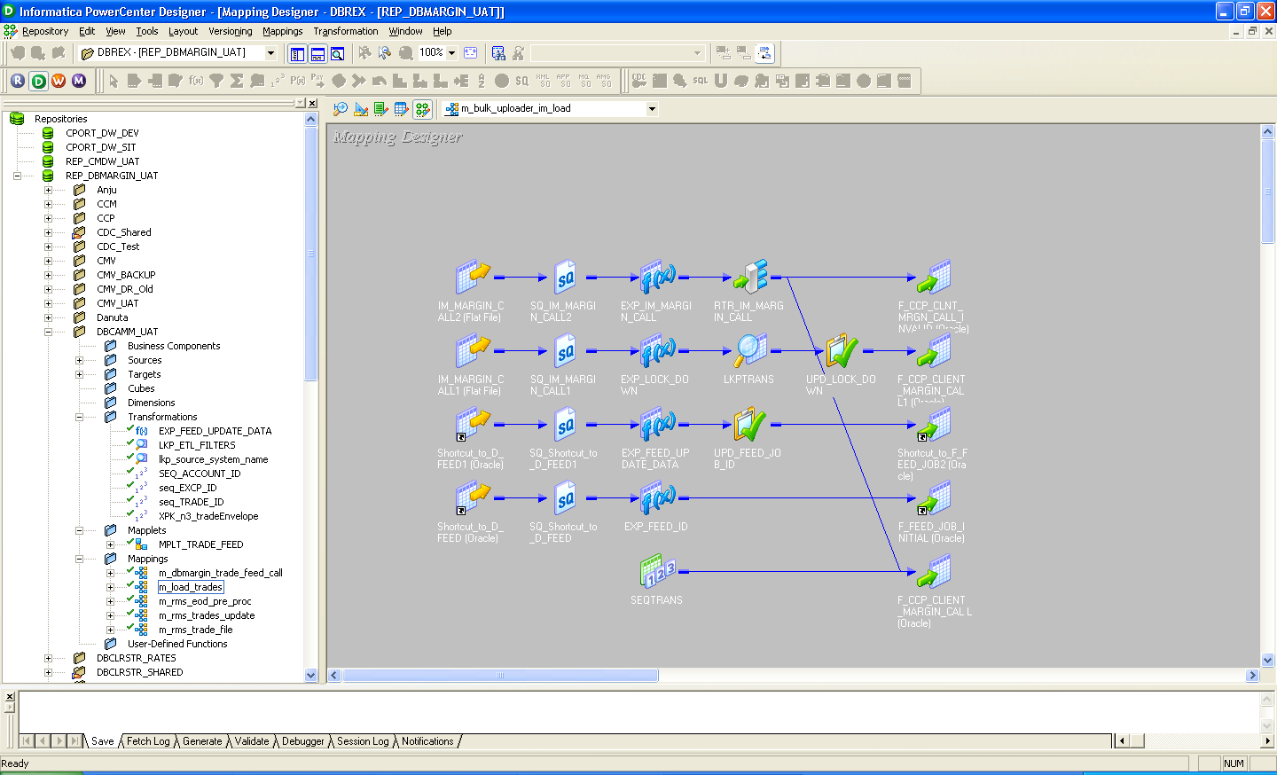
Designer Overview (Contd.)

Slide 16
Designer Overview (Contd.)
Mappings represent the data flow between sources and targets
When the Informatica Server runs a session, it uses the instructions configured in the mapping to read, transform, and write data
Every mapping must contain the following components:
Source / Target definitions
Transformation / Transformations
Connectors or Links
Transformations can be created to use once in a mapping, or reusable transformations to use in multiple mappings

Slide 17
Transformations Overview
A transformation is a repository object that generates, modifies, or passes data
The Designer provides a set of transformations that perform specific functions
Transformations in a mapping represent the operations the Informatica Server performs on data
Data passes into and out of transformations through ports that you connect in a mapping or mapplet

Slide 18
Basic Transformations used in Designer
Source Qualifier Transformation
This object is used to define the reader process, or the selection for relational sources
Can automatically generate the SQL, User can override it and write own SQL
In the source qualifier you can also specify filters on the source data or distinct selection
Filter Transformation
The Filter Transformation is used to do just that – filter data
We can filter at the source using the Source Qualifier, but maybe we need to filter the data somewhere within the pipeline. We also use the Filter to branch and load a portion of the data into one target based on some condition and the rest of the data into another target
Router Transformation
It is used for branching, it’s much more efficient than the filter transformation

Slide 19
Basic Transformations used in Designer(Cont.)
Expression Transformation
The Expression Transformation is used for data cleansing and scrubbing
Functions such as concatenate, instring and rpad etc. can be used in the Expression Transformation
We can also create derived columns and variables in the Expression Transformation
Aggregator Transformation
The Aggregator Transformation is used when doing those types of functions that require sorting or a group by. Functions like SUM, AVG
Aggregates are done in memory and we can accept pre-sorted input to reduce the amount of memory necessary.
Update Strategy Transformation
Use the update strategy to finely control on a row by row basis, whether we want the row to be inserted, updated, deleted or a reject based on some logical condition we have derived in the mapping process

Slide 20
Basic Transformations used in Designer(Cont.)
Joiner Transformation
The Joiner Transformation is used for heterogeneous joins within a mapping
Joins are done in memory
Sorter Transformation
The Sorter is used to sort the data in the Ascending or the Descending order, generally used before aggregation of data
Sequence Generator Transformation
It just works like sequence in Oracle
You can specify the starting value, the increment value, the upper limit and whether or not you want to reinitialize
Normalizer Transformation
It is used when you have occurs or arrays in your source data and you want to flatten the data into a normalized table structure
It is also used to pivot data

Slide 21
Basic Transformations used in Designer(Cont.)
Stored Procedure Transformation
If we have already written a stored procedure/function, you can call them from within a mapping using the Stored Procedure Transformation.
We import the stored procedure arguments the same way we import the source catalog definition
Lookup Transformation
Use the Lookup Transformation to lookup tables in the source database, the target database or any other database as long as we have connectivity.
Lookups are by default cached in memory, however you can turn off the caching by checking the option
Stored Procedure and lookup transformations cab be used as connected as well as unconnected depending on the usage

Slide 22
Workflow Manager

Slide 23
Workflow Basics
A workflow is a set of instructions on how to execute tasks such as sessions, emails, and shell commands
A session is one of the many tasks you can execute in the Workflow Manager
We can also create branches with conditional links. In addition, you can batch workflows by creating worklets in the Workflow Manager
Workflow Manager tools include the following:
Task Developer - To create tasks you want to execute in the workflow
Workflow Designer – To create a workflow by connecting tasks with links. We can also create tasks in the Workflow Designer as you develop the workflow
Worklet Designer - To create a worklet

Slide 24
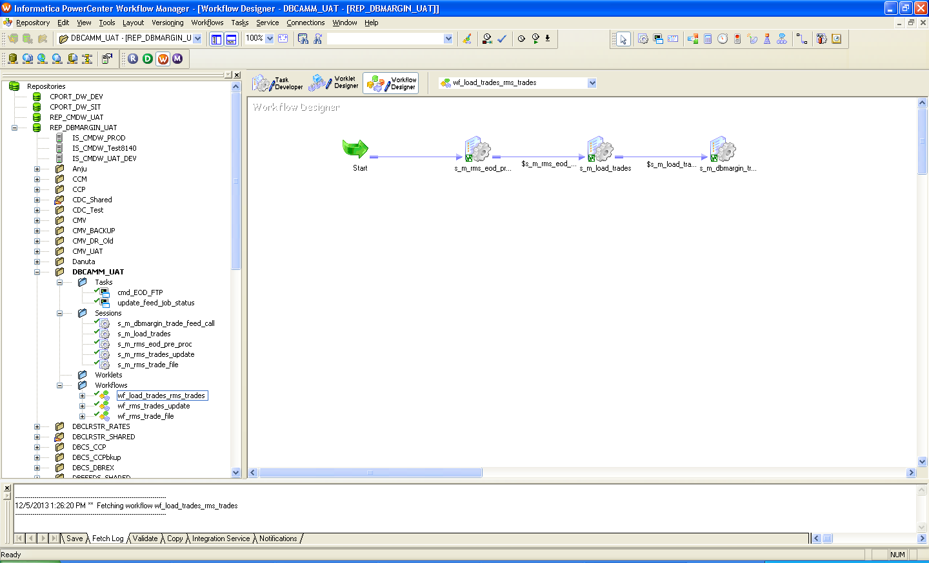
Workflow Basics (Contd.)

Slide 25
Session Properties
The session properties dialog box enables you to configure the following properties:
Source Database connection/flat file name
Target Database connection/flat file name
Session log file directory
Session log file name
Parameter file name
Flat file properties
Commit intervals
Pre-SQLs/Post-SQLs
Pre-session command – batch commands/Unix commands
Post-session command - batch commands/Unix commands
Email
We can over-write some of the mapping level properties in the sessions.

Slide 26
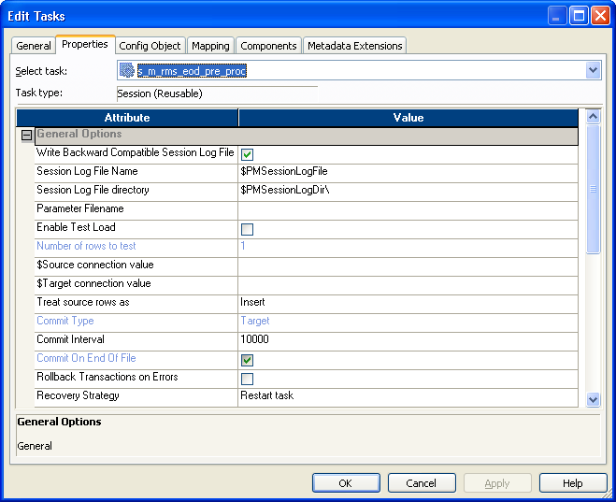
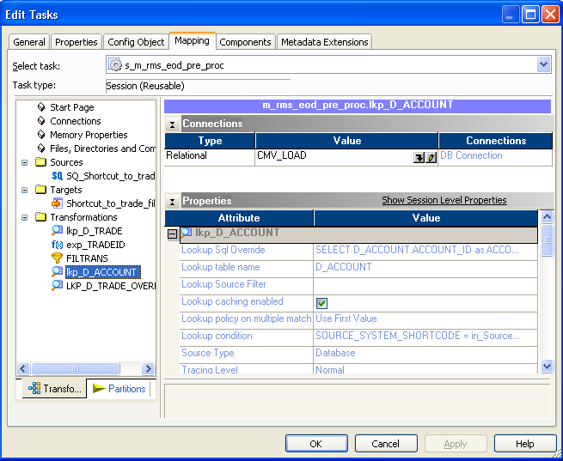
Session Properties (Contd.)

Slide 27
Workflow Properties
The workflow properties dialog box enables you to configure the following properties:
Integration Service
Scheduling options
Workflow log file directory
Workflow log file name
Parameter file name
We can over-write some of the session level properties in the workflow.

Slide 28
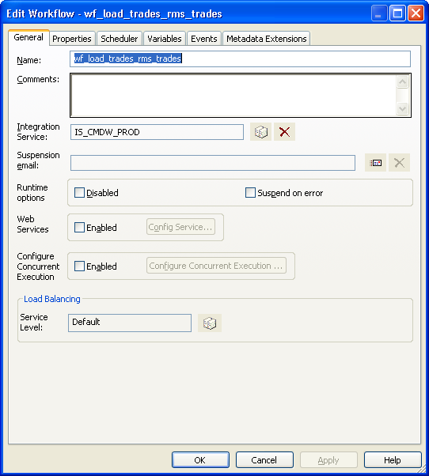
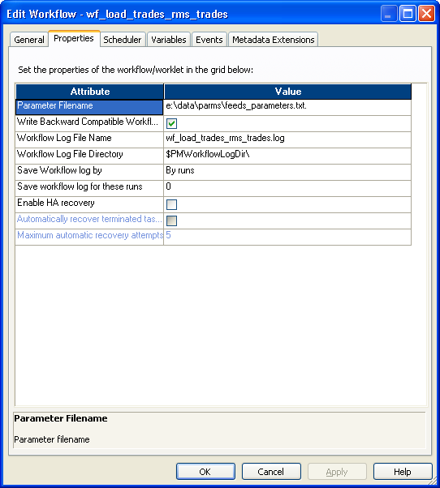
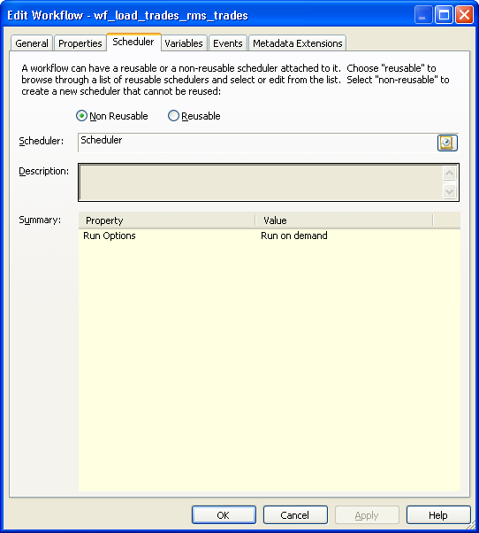
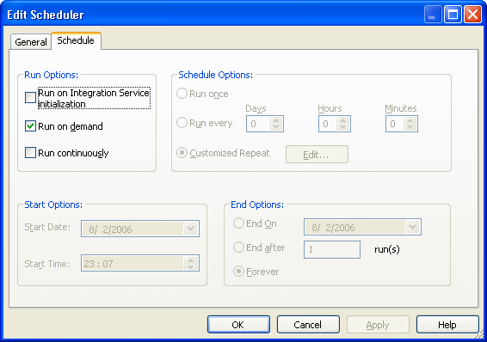
Workflow Properties (Contd.)

Slide 29
Scheduling and Running Workflows
After we have configured the scheduling properties, the workflow is scheduled
When a workflow is scheduled and it fails then it gets unscheduled
In order to re-schedule, unschedule or run the workflow, choose the appropriate action from the ‘workflow’ menu
We can choose to run specific session of a workflow as well instead of running the complete workflow

Slide 30
Workflow Monitor

Slide 31
Workflow Monitor Details
The Workflow Monitor displays information about workflows in two views:
Gantt Chart view
Task view
The Workflow Monitor displays workflow runs in Task view chronologically with the most recent run at the top
We can check the session, workflow logs for debugging purposes or to check for performance bottlenecks

Slide 32
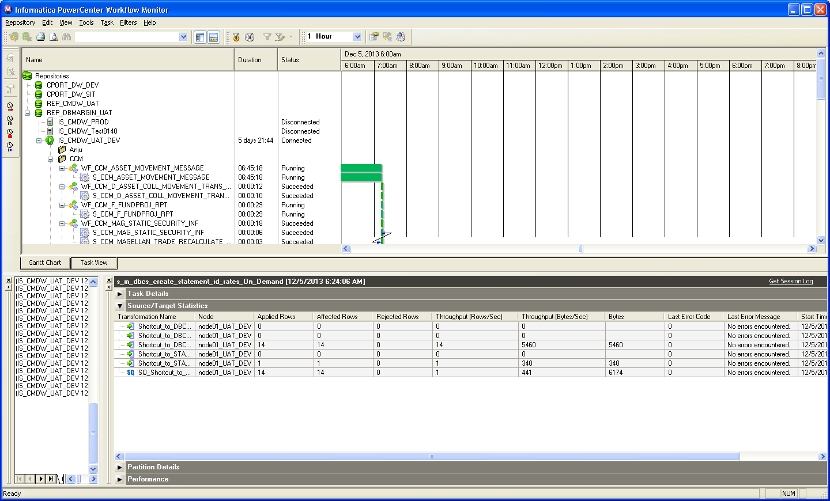
Workflow Monitor Details (Contd.)

Slide 33
Repository Manager

Slide 34
Repository
The Informatica repository tables have an open architecture
Metadata can include information such as
mappings describing how to transform source data
sessions indicating when you want the Informatica Server to perform the transformations
connect strings for sources and targets
The repository also stores administrative information such as
usernames and passwords
permissions and privileges

Slide 35
Repository (Contd.)
We Can create and store the following types of metadata in the repository:
Database connections
Global objects
Mappings
Mapplets
Multi-dimensional metadata
Reusable transformations
Sessions and batches
Shortcuts
Source definitions
Target definitions
Transformations

Slide 36
Repository Manager Tasks
Perform repository functions:
Create, backup, copy, restore, upgrade, and delete repositories
Make a repository as global repository
Register and unregister local repositories with a global repository
Implement repository security:
Create, edit, and delete repository users and user groups
Assign and revoke repository privileges and folder permissions
View locks and unlock objects
Perform folder functions:
Create, edit, and delete folders
Copy a folder within the repository or to another repository
Compare folders within a repository or in different repositories
Add and remove repository reports

Slide 37
Integration Service

Slide 38
Integration Service (IS)
The Integration Service is an application service that runs data integration sessions and workflows
When a session starts, the IS retrieves mapping and session metadata from the repository database through Repository Service initiating a repository service process
The IS moves data from sources to targets based on mapping and session metadata stored in a repository database

Slide 39
Repository Service

Slide 40
Repository Service
Informatica client applications and IS access the repository database tables through the Repository Service
Informatica client connects to the Repository Service through the host name/IP Address and its port number
The Repository Service can manage multiple repositories on different machines on the network
For each repository database registered with the Repository Service, it configures and manages a Repository Service process

Slide 41
Administration Console

Slide 42
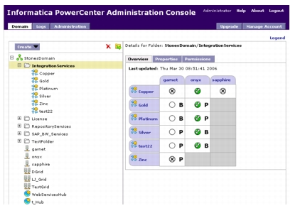
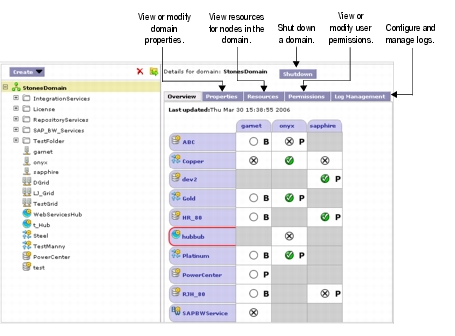
Administration Console
This Web interface allows the administrator to monitor the Integration Services and Repository Services

Slide 43
PMCMD

Slide 44
PMCMD
PMCMD is a command line program to communicate with the Informatica Server
We can perform the following actions with pmcmd:
Determine if the Informatica Server is running
Start sessions and batches
Stop sessions and batches
Recover sessions
Stop the Informatica Server
configure repository usernames and passwords as environmental variables with pmcmd
Customize the way pmcmd displays the date and time on the machine running the Informatica Server

Slide 45
PMCMD (Contd.)
pmcmd returns zero on success and non-zero on failure
pmcmd can be used with operating system scheduling tools like cron to schedule sessions, and it can be embedded into shell scripts or Perl programs to run or schedule sessions
In order to use pmcmd the following Information is required:
Repository username
Repository password
Port or connection - The TCP/IP port number or IPX/SPX connection (Windows NT/2000 only) to the Informatica Server
Host name - The machine hosting the Informatica Server
Session or batch name - The names of any sessions or batches you want to start or stop
Folder name - The folder names for those sessions or batches
Parameter file

Slide 46
Thank You

Slide 47
Questions ???

